Slide 1
Hand Gesture Recognition
By
Aarurnathan G 1407001
Aswin L 1407007
Vasanthkumar M 1407056

Slide 2
introduction
Human-computer interaction is a discipline concerned with the design, evaluation and implementation of interactive computing systems for human use and with the study of major phenomena surrounding them.
A basic goal of HCI is
to improve the interactions between users and computers
by making computers more usable and receptive to the user's needs.
A long term goal of HCI is
to design systems that minimize the barrier between the human's cognitive model of what they want
to accomplish the computer's understanding of the user's task

Slide 3
Abstract
The focus of this research is to recognize hand gestures captured from a webcam in real-time using K curvature Algorithm.
This comes under static and dynamic hand recognition system.
Keywords: Skin color extraction, hand gesture recognition, motion detection, canny edge detection.

Slide 4
System overview
The system is composed of two independent sub systems They are
Static hand gesture recognition system.
Dynamic hand gesture recognition system(Virtual Mouse)
The main objective of static hand gesture recognition system is to recognize number of fingertips present in the hand image captured through a webcam using K curvature algorithm.
Virtual Mouse System changes the hand position implemented using the centroid tracking method. This project focuses more on the static and dynamic hand gesture recognition system.

Slide 5
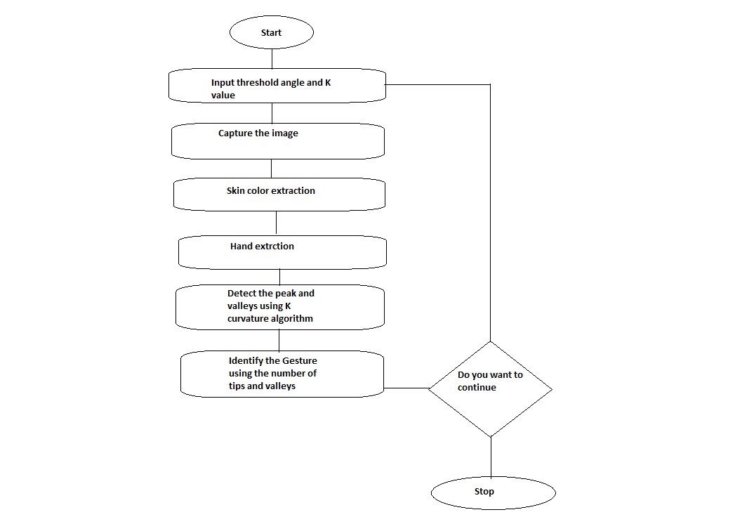
Flow chart of Static Recognition
The static hand gesture recognition is used to find out the static hand movements like the number of fingers in the hand and performs application according to that.
The peaks and valleys are extracted using the k curvature method.
Using the co- ordinate values of tips and valleys we plotted the captured image.

Slide 6
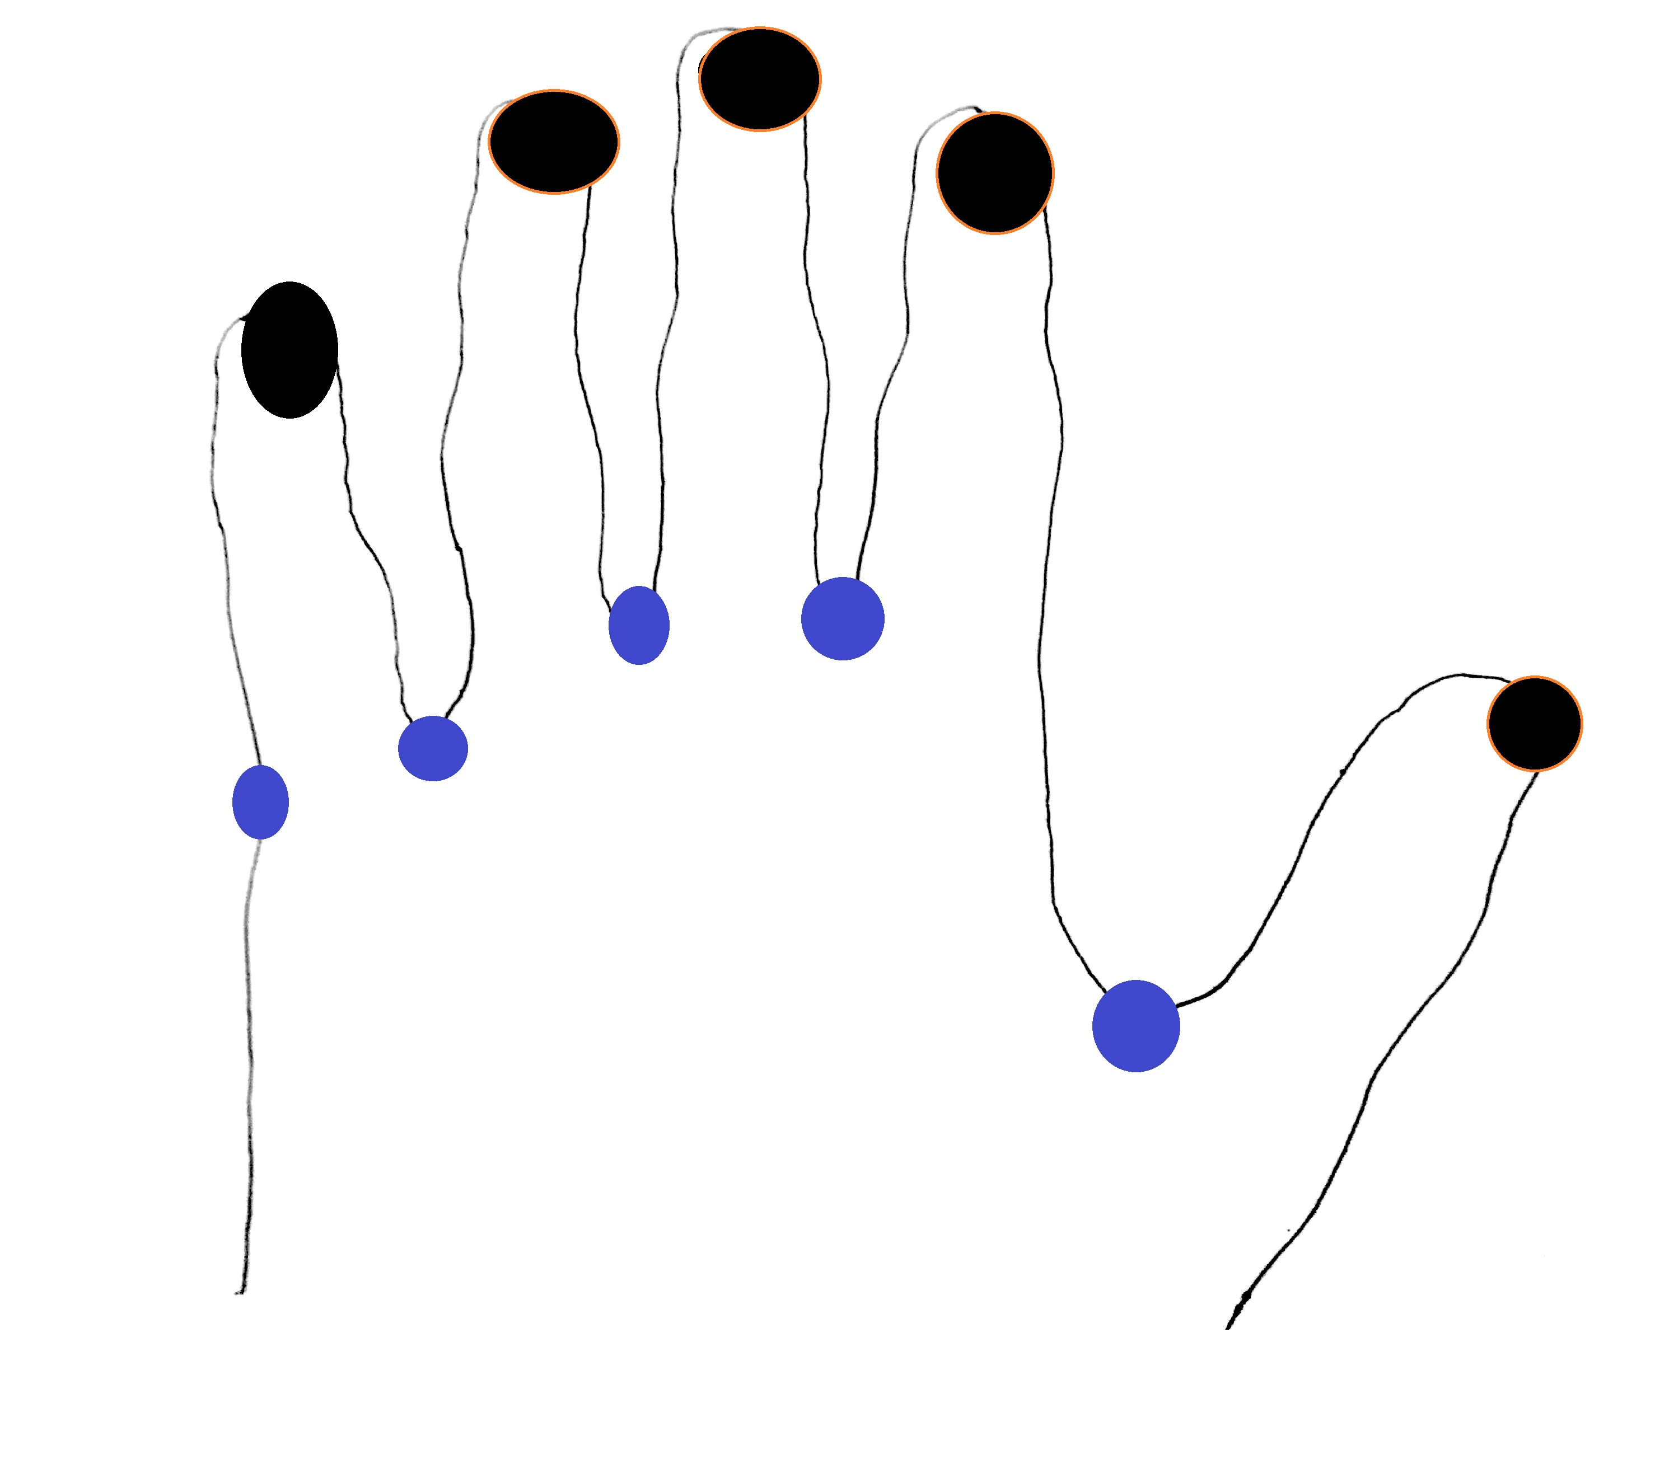

Edge Tracking Algorithm
For this we use Edge Tracking Algorithm:
Let the initial points be Po, Qo. Given P and Q find the next pair P’ and Q’ as follows:
We now traverse in clockwise direction from R2 and find 1st white pixel.
Assign this white pixel to P and assign R(i-1) to Q.
We repeat this process until the last point on the hand contour is reached
Valleys
Peaks
Table. 1: Edge Tracing Point Scenario

Slide 7
K-Curvature algorithm
We attempt to find pixels that represent peaks.
At each pixel j in a hand contour i, we compute the k-curvature which is the angle between the two vectors [Ci(j), Ci(j – k)] and [Ci(j), Ci(j + k)], where k is a constant.
Theta=Tan^-1[(m1-m2)/(1-m1*m2)]
We use a threshold angle for the k-curvature.
An important issue in K Curvature Algorithm is about obtaining co-ordinates of the points on the hand contour to draw tangents in order in which they appear.

Slide 8
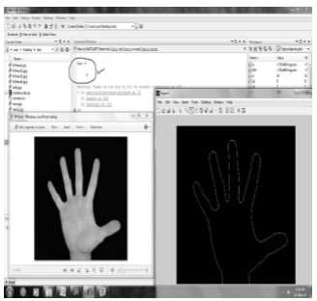
Canny Edge Detection

Slide 9
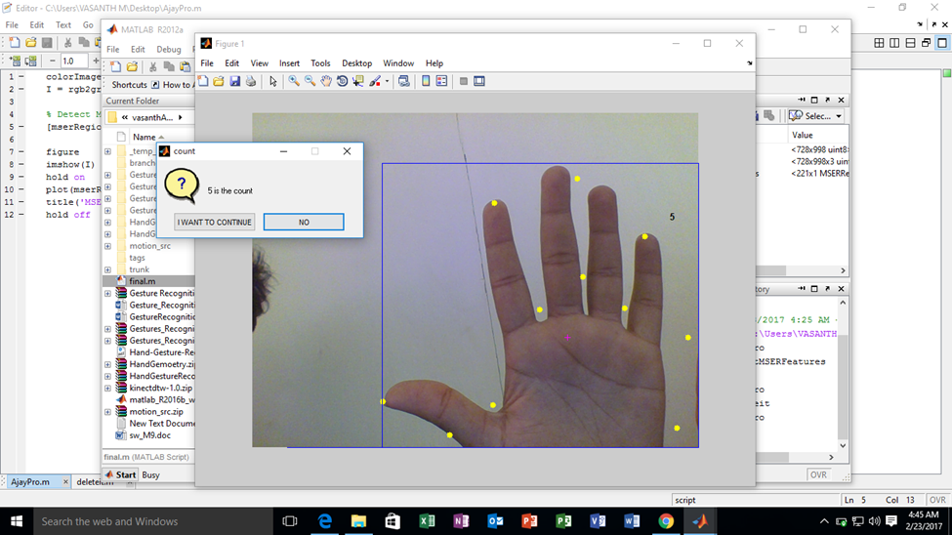
Output - 1

Slide 10
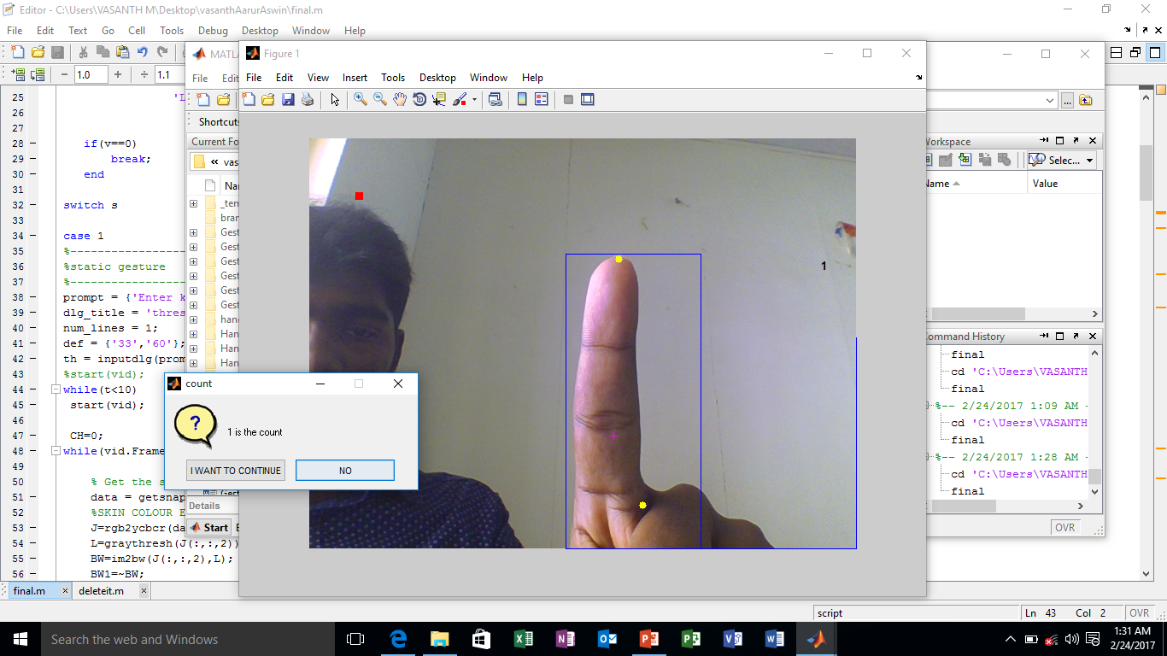
Output - 2

Slide 11
Dynamic Hand Gesture Recognition
The main objective of this section is to track the hand movement and feasibly apply it to control mouse pointer movements.
This system tracks the hand motion that is it identifies whether the hand moves right, left, up or down.
Apart from this some dynamic gestures can be recognized to perform mouse clicking operations.

Slide 12
Dynamic Hand Gesture Recognition(Contd)
The centroids of the binary image can be calculated using the MatLab function regionprops, here the properties will be centroid. The result will be the vertical and horizontal (x, y) coordinates of the centroid.
Since the input binary image BW will contain only one white region (hand extracted image) the result of the function region props will be the centroid of the hand.
By passing this centroid value to the java.awt.Robot we can change the position of the mouse pointer.

Slide 13
Application
ActiveX is a Microsoft Windows protocol for component integration. With help of ActiveX, it is possible to integrate MatLab and Microsoft media player.
Cricket umpiring
For blind communication
For smart home techniques
Traffic control
Virtual gaming etc.,
Requirements
Proper lighting is required
Works fine with plain background
Images with low resolution is not supported

Slide 14
Thank you ☺

